Slide 1

Grocery Store Management
Presented By:
Shaik Abidh

Slide 2
About Me
Name: Shaik Abidh
Education: B Tech CSE
Batch no: 477
Enrollment ID: 81021000425

Slide 3
Agenda
Introduction to Dataset
Objective of the Project
Dataset Overview (Suppliers, Categories, Employees, Customers, Products, Orders, Order Details)
ER Diagram
Key Analysis Questions
SQL Analysis & Findings
Insights & Conclusion
Challenges Faced

Slide 4

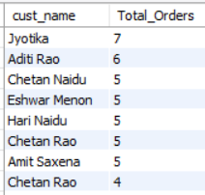
1.Which customers have placed the highest number of orders?
Query
Output
Jyotika is the top customer with the highest orders (7), followed by Aditi Rao (6).
Several customers consistently placed 5 orders, forming a strong repeat customer base.
Duplicate name (Chetan Rao) suggests either multiple customers or a data quality issue

Slide 5
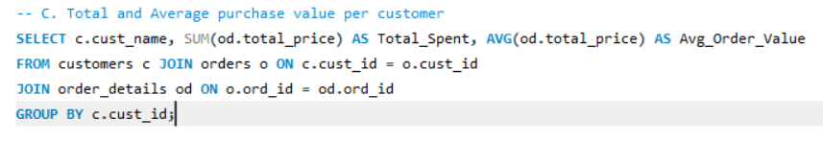
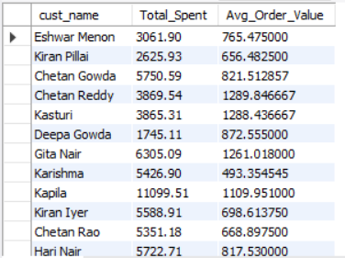
2.Total and Average Purchase value per customer?
Query
Output
Eshwar Iyer is the top spender overall, showing the highest total purchase value (Total _ Spent) across all customers.
Isha Rao records the highest average order value (Avg_Order _Value), despite not leading in total spend — meaning fewer orders, but each of higher value.

Slide 6
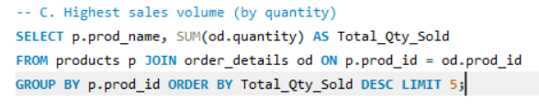
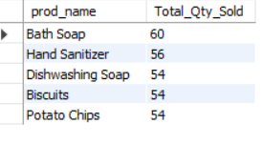
3.Highest Sales Volume (by quantity)
Query
Output
Bath Soap leads with 60 units sold, closely followed by Hand Sanitizer (56), and a tight cluster of Biscuits, Potato Chips, and Dishwashing Soap tied at 54 units each.
The top 5 products by volume are all everyday essentials, indicating high-frequency, repeat-purchase items drive unit sales more than premium products.

Slide 7
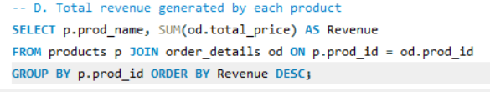
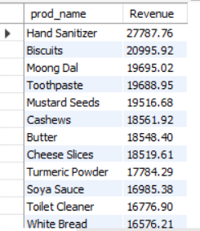
4.Total revenue generated by each product
Query
Output
Hand Sanitizer is the top revenue generator (₹27,788), followed by Biscuits (₹20,996), Moong Dal (₹19,695), Toothpaste (₹19,689), and Mustard Seeds (₹19,517).
Pasta and Yogurt sit at the bottom (under ₹1,700 each), showing a wide revenue gap between top and bottom performers in the catalog.

Slide 8
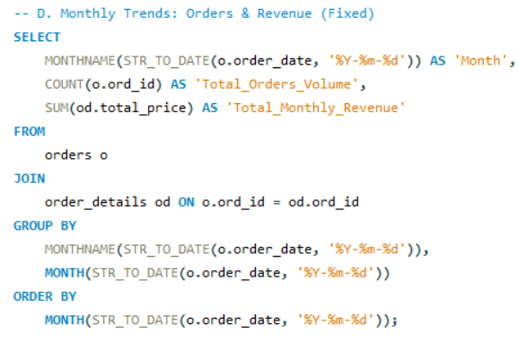
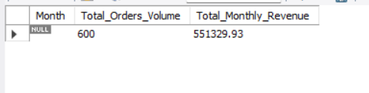
5.Monthly Trends: Orders & Revenue (Fixed)
Query
Output
January is the strongest month with 35 orders and ₹70,312 in revenue, while orders dip noticeably in April, June, and October.
Revenue recovers by December (34 orders, ₹60,903), suggesting a seasonal pattern useful for planning promotions and stock levels around low and peak months.

Slide 9
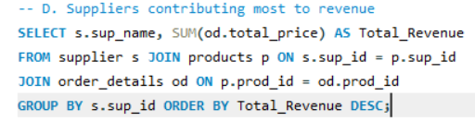
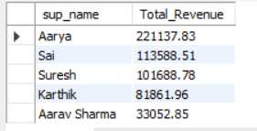
6.Suppliers contributing most to revenue
Query
Output
Aarya is the dominant supplier, generating ₹2,21,138 in revenue — more than double the second-highest supplier, Sai (₹1,13,589).
The lowest contributor, Aarav Sharma, brings in only ₹33,053, highlighting a heavy dependency on one or two key suppliers.

Slide 10
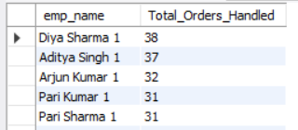
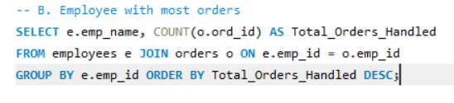
7.Employee with most orders
Query
Output
Diya Sharma handled the most orders (38), followed closely by Aditya Singh (37) and Arjun Kumar (32).
The top 4 employees are tightly clustered (31–38 orders), reflecting a strong, consistently performing core team rather than one standout outlier.

Slide 11
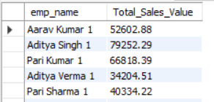
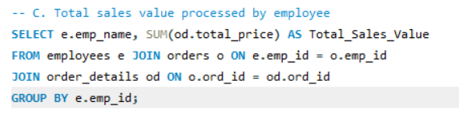
8.Total sales value processed by employee
Output
Query
Aditya Singh processed the highest sales value overall (₹79,252), followed by Zara Verma (₹71,563) and Diya Sharma (₹67,242).
Interestingly, Diya Sharma handled the most orders but ranks third in sales value — showing order count and revenue impact don't always move together per employee.

Slide 12
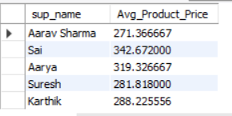
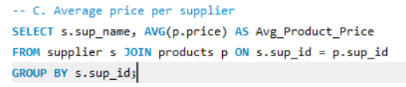
9.Average price per supplier
Query
Output
Sai supplies the highest-priced products on average (₹342.67), while Aarav Sharma's products are the most affordably priced (₹271.37).
This roughly ₹71 gap suggests suppliers are positioned differently — some toward premium pricing, others toward budget-friendly volume products.

Slide 13
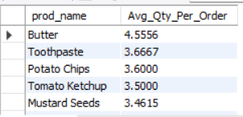
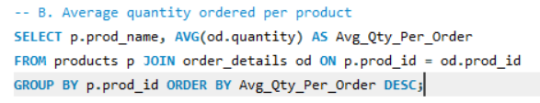
10.Average quantity ordered per product
Query
Output
Butter has the highest average order quantity (4.56 units per order), followed by Toothpaste (3.67) and Potato Chips (3.6).
Soybean Oil has the lowest average quantity per order (1.64), suggesting it's a low-volume, top-up purchase rather than a bulk-buy item.

Slide 14
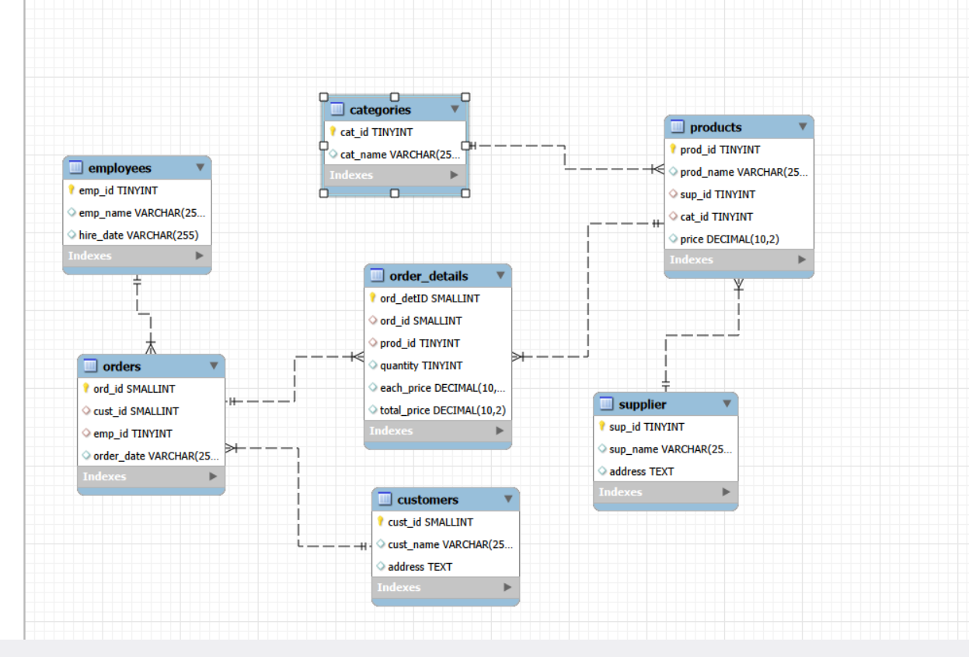
ER Diagram

Slide 15
Insights
The store generated ₹5,51,330 in revenue from 300 orders across 156 customers, with an average order value of ₹2,153.63.
Jyotika is the most loyal customer (7 orders), while Hand Sanitizer is the top-selling product by revenue (₹27,788).
Grains & Cereals and Snacks & Confectioneries dominate the catalog, while Household remains a thin, under-expanded category.
Revenue is heavily concentrated in one supplier (Aarya, contributing over 2x the next-highest supplier), signaling a dependency risk.
Aditya Singh leads in sales value processed, though Diya Sharma handled the most individual orders — showing value and volume don't always align.

Slide 16
Conclusion
Overall business performance is healthy, with ₹5,51,330 in revenue across 300 orders, but growth is concentrated in a few customers, products, and suppliers rather than spread evenly.
Strengthen loyalty programs around repeat customers like Jyotika and top spenders, since a small customer base is driving a disproportionate share of orders.
Focus inventory and marketing on proven top-sellers like Hand Sanitizer, Biscuits, and Moong Dal, while considering expansion of the underdeveloped Household category.
Reduce reliance on a single dominant supplier (Aarya) by diversifying sourcing, to safeguard against supply disruptions.
Recognize and replicate high-performing employee patterns (e.g., Aditya Singh, Diya Sharma) through training or incentive alignment across the team.
Plan staffing, inventory, and promotions around the seasonal dip (April–October) and the January/December peaks to smooth out revenue fluctuations.

Slide 17

THANK YOU

